Slide 1
Data Mining & Knowledge Engineering
Case Study in Data Mining

Slide 2
Learning Outcome
To understand how a real world data mining problem was undertaken

Slide 3
Case Study Overview
Telecommunications company in NZ wanted to mine data streaming in from its mobile call network
Volume of data: approximately 10GB of compressed data streaming daily
Each record consists of 147 attributes and represents a call made by a subscriber

Slide 4
Case Study Objectives
Three major objectives:
Traffic Prediction - produce a 2D map predicting call density at a given location and a given date/time
Understand the behaviour of the network – the relationship between key network parameters and call quality
Understand subscriber behaviour – duration of calls, types of calls, etc.

Slide 5
Data Pre-processing
Due to the enormous volume of data, filtering needed to be carried out by reducing the number of attributes as well as the number of records
PCMD database
PCMe
Voice Filter
Filter on significant predictors for subscriber and network profiling
Hash filter applied on individual calls

Slide 6
Data Architecture
Due to the continuous streaming nature of the data, a data warehouse needed to be built
In the mobile Telecommunications area, patterns change quite frequently and so a scheme had to be put in place that will purge old data and replace it with new data
A 4 dimensional data warehouse was constructed and implemented in MS SQL Server.
Dimensions: Call, Time, Location and Subscriber

Slide 7
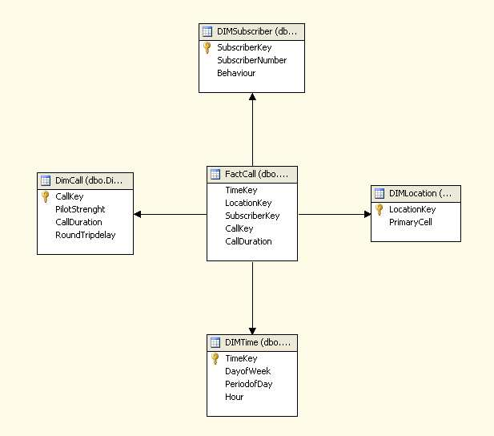
Data Warehouse Schema

Slide 8
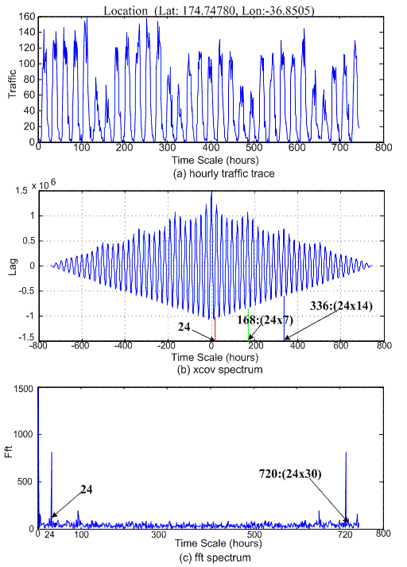
Traffic Prediction Experiments-
Results: Periodical Analysis
Hourly traffic trace spectrum analysis

Slide 9
Traffic Prediction Experiments-
Results: Periodical Analysis
The periodogram based on the above hourly and daily traffic trace spectrum analysis, can be summarized as:
  The main frequency of spectrum indicating the period of the current network traffic is 24 hours.
  The second harmonic shown in the spectrum suggests an asymmetry of network traffic in 7 days period.
  Fortnight is also an important period for the traffic network, due to that the third harmonic is 336 (24*14).
  Month period is also shown from FFT spectrum.

Slide 10
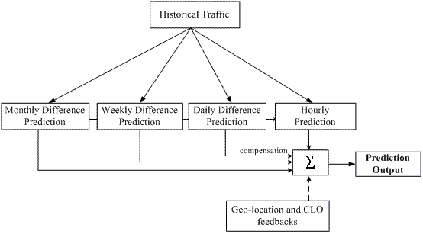
Proposed traffic prediction solution

Slide 11
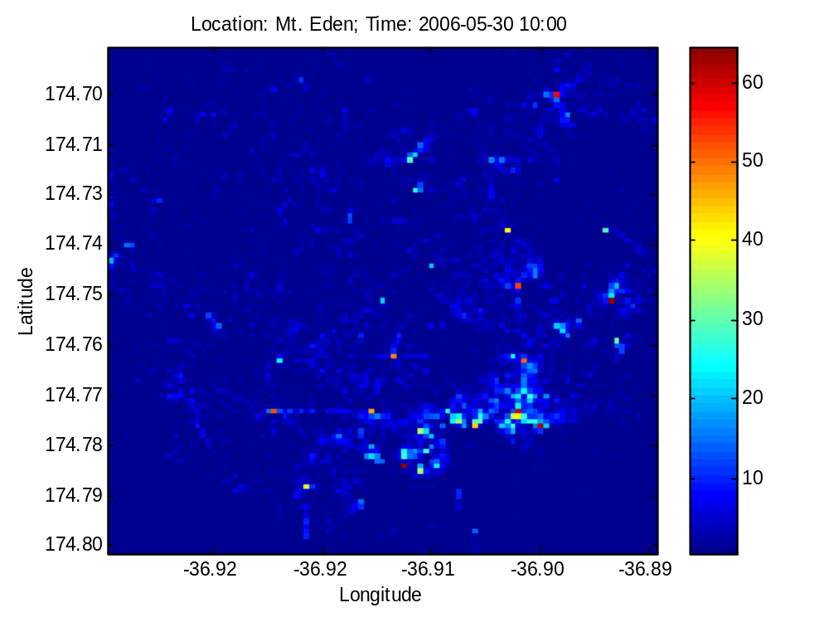
Results: Actual Traffic Density

Slide 12
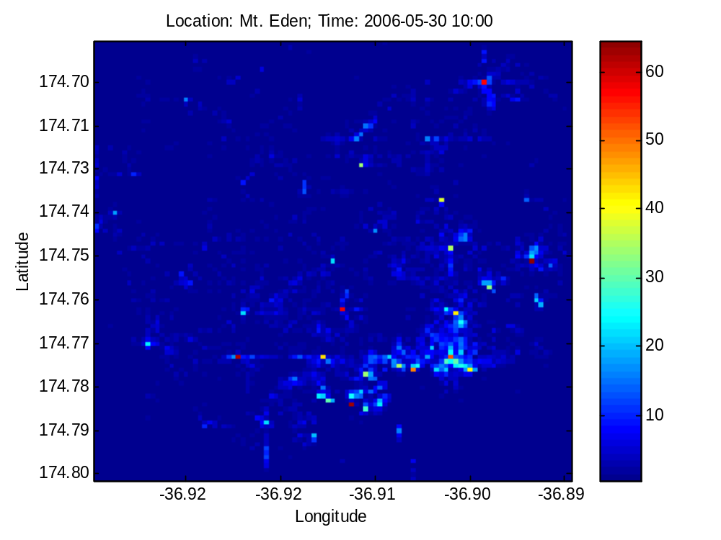
Results: Predicted Traffic Density

Slide 13
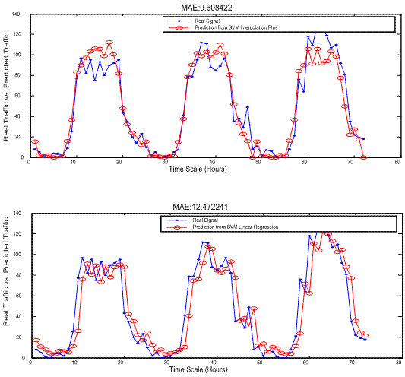
Traffic Predictions

Slide 14
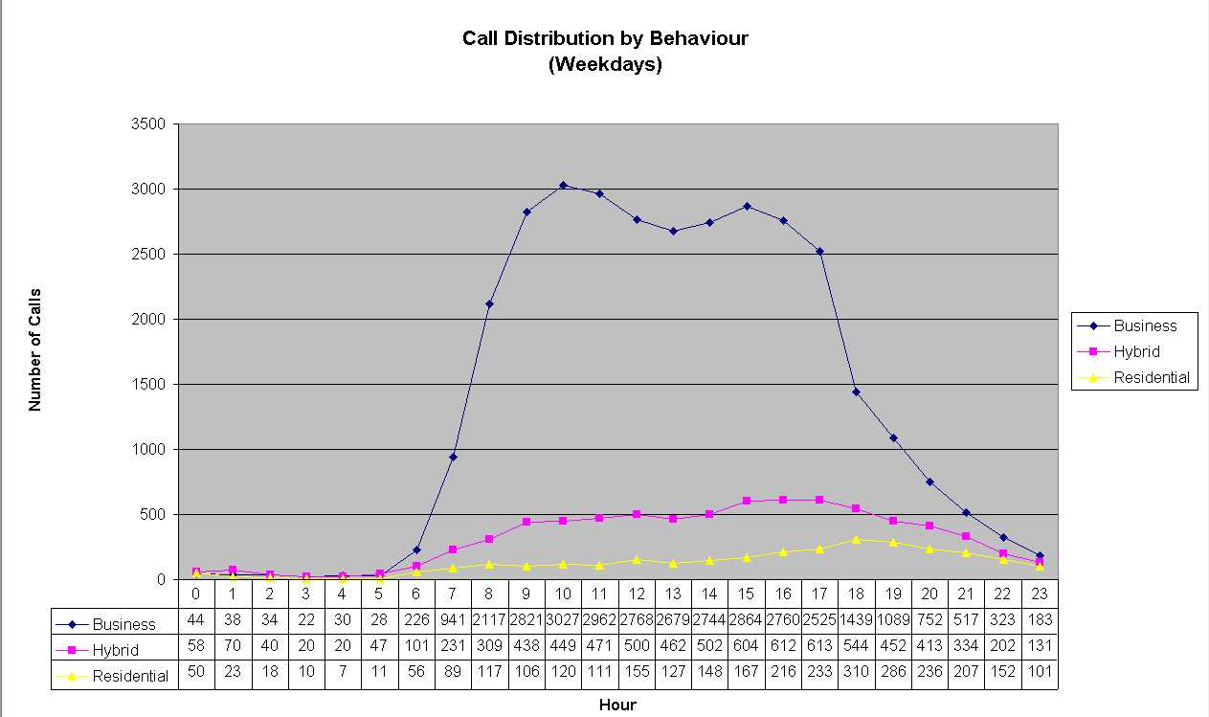
Network and Subscriber Profiling – OLAP Analysis

Slide 15
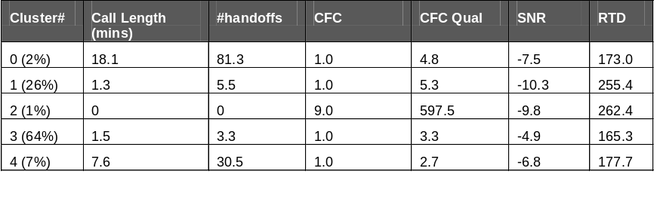
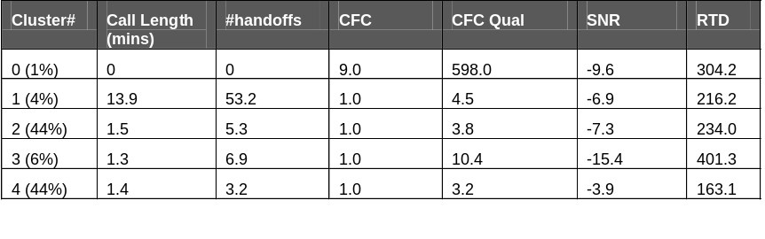
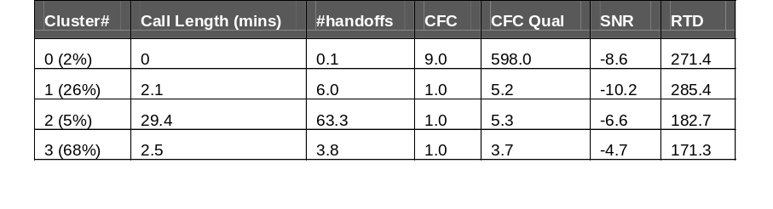
Network Profiling – Clustering
The K-means algorithm was used to segregate the data into well-defined categories
Profile for 8-18 time window (weekday)
Profile for 18-0 time window (weekday)
Profile for 8-18 time window (weekend)

Slide 16
Network Profiling – Association Rule Analysis
The Tertius association rule mining algorithm was used to capture strong relationships between key network variables
1. CFC = not_normal ==> call_length = low
2. handoffs = low ==> call_length = low
3. SNR = high ==> RTD = low
4. SNR = medium ==> RTD = high
5. RTD = high ==> call_length = low or SNR = medium
6. RTD = high ==> call_length = low or handoffs = low or handoffs = medium or SNR = low
7. SNR = low ==> call_length = low
8. RTD = high ==> call_length = low

Slide 17
Subscriber Profiling – Three Class Model
Logistic regression was used to fit a model to subscriber profiles that were constructed from the DW
The subscriber profiles were of the form:
subscriber#, ts1, ts2, ts3, ts4, ts5, ts6, usage, where the ts1, ..ts6 represent the volume of calls during six time slots during the day and Usage refers to the subscriber types
  Accuracy on training data set
  Correctly Classified Instances 575 78.2 %
  Incorrectly Classified Instances 160 21.8 %
  === Confusion Matrix ===
  a b c <-- classified as
  215 43 23 | a = Hybrid
  50 114 3 | b = Residential
  40 1 246 | c = Business
  Accuracy on test data set
  Correctly Classified Instances 514 73.9 %
  Incorrectly Classified Instances 182 26.1 %
  Total Number of Instances 696
  === Confusion Matrix ===
  a b c <-- classified as
  218 57 3 | a = Hybrid
  34 134 0 | b = Residential
  88 0 162 | c = Business

Slide 18
Subscriber Profiling – Two Class Model
Subscribers were re-labelled as either Business or Residential and a new model was created
Correctly Classified Instances 662 90.1 %
Incorrectly Classified Instances 73 9.9 %
0.944 0.167 0.898 0.944 0.921 Residential
0.833 0.056 0.905 0.833 0.868 Business
=== Confusion Matrix ===
a b <-- classified as
423 25 | a = Residential
48 239 | b = Business

Slide 19
Subscriber Profiling – Scoring Process
Regression coefficients and call volume by time slot were used together to score individual subscribers
Examples:
subscriber# ts1 ts2 ts3 ts4 ts5 ts6
123456789, 15,334, 75,322, 19, 18, Business
Business Score (B) = 0.98; Residential Score (R) = 0.02
subscriber# ts1 ts2 ts3 ts4 ts5 ts6
434481230, 17, 5, 3, 12, 10, 69, Residential
B = 0.21; R = 0.79
subscriber# ts1 ts2 ts3 ts4 ts5 ts6
875067266, 7, 9, 0, 18, 6, 10, Hybrid
B = 0.56; R = 0.44

Slide 20
Insights – 1
  High Signal-to-Noise Ratio (SNR) is associated with low Round Trip Delay (RTD), as SNR is inversely proportional to RTD. SNR is directly proportional to call length.
  A ‘typical’ call has high SNR and short RTD, but there are also potentially significant proportions of calls (up to 26% depending on the time window) with relatively poor SNR and long RTD.
  Calls made under circumstances with low SNR or long RTD tend to be short – only up to one minute long.
  More generally, there is evidence to suggest that call length is directly related to SNR. This implies that network improvements leading to improved SNR could then lead to longer duration calls.

Slide 21
Insights – 2
  The number of calls with duration up to 3 min show a shift for Hybrid and Residential subscribers during off-peak hours.
  Calls with duration up to 10 min are predominantly made by Business subscribers during business hours.
  Calls above 10 min are distributed consistently among the three profiles irrespective of the time of day, with a large volume increase during off-peak hours.
  There is no evidence of a shift in terms of call duration distribution per behaviour profile on different days for the business hour time slots (although absolute call volumes do differ markedly).

